Slide 1

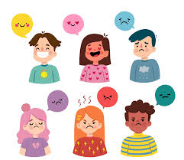
fNIRS study on emotional recognition task in individuals with addiction to short-form videos
Han Chenyu MC364483
Xu Qihao MC364202
Liu Qianru MC364305

Slide 2
01
Background
CONTENT
02
Idea
03
Experimental design
04
Potential implications

Slide 3


Background
Internet addiction
A disorder in which an individual’s inability to control his or her use of the Internet.
Negative consequences on users’ well-being, such as mental health problems, attention difficulties, and poor interpersonal quality
Short-form video addiction
Subcategory of Internet addiction.
Growing public concern with the popularity of short-form video applications.

Slide 4
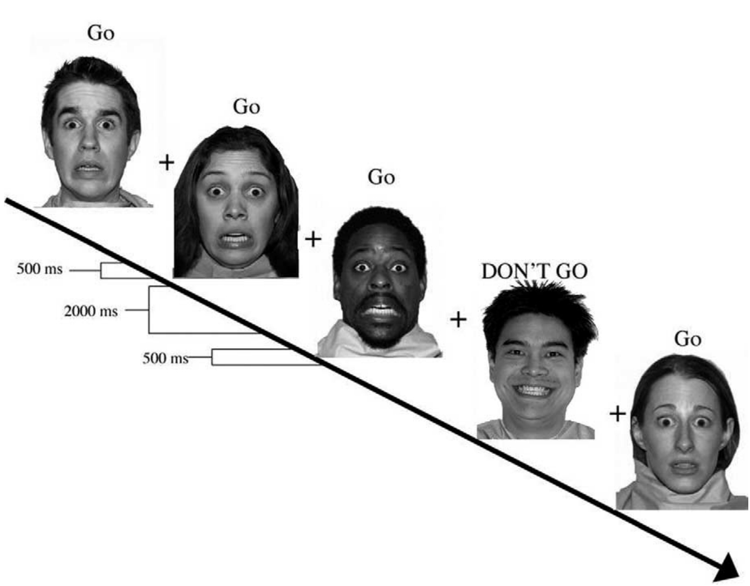
Background
The Emotional Recognition Go/ NoGo task is a cognitive task designed to assess information processing bias between different facial expressions.
In this task, participants must respond to a particular emotional facial expression (neutral, sad, happy and so on) (Go trials) and not respond (NoGo trials) to another emotional facial expression.Reaction times(RT) will be recorded for further calculations to get emotional bias scores.
Notes:
The emotional recognition Go/NoGo task is a good method of studying emotional processing of people.The Emotional Recognition Go/ NoGo task is a modified version of the Probability Go/NoGo task. It is a cognitive task designed to assess information processing bias between different facial expressions. In this task, participants must respond to a particular emotional facial expression and not respond to another emotional facial expression.Reaction times will be recorded for further calculations to get emotional bias scores.

Slide 5
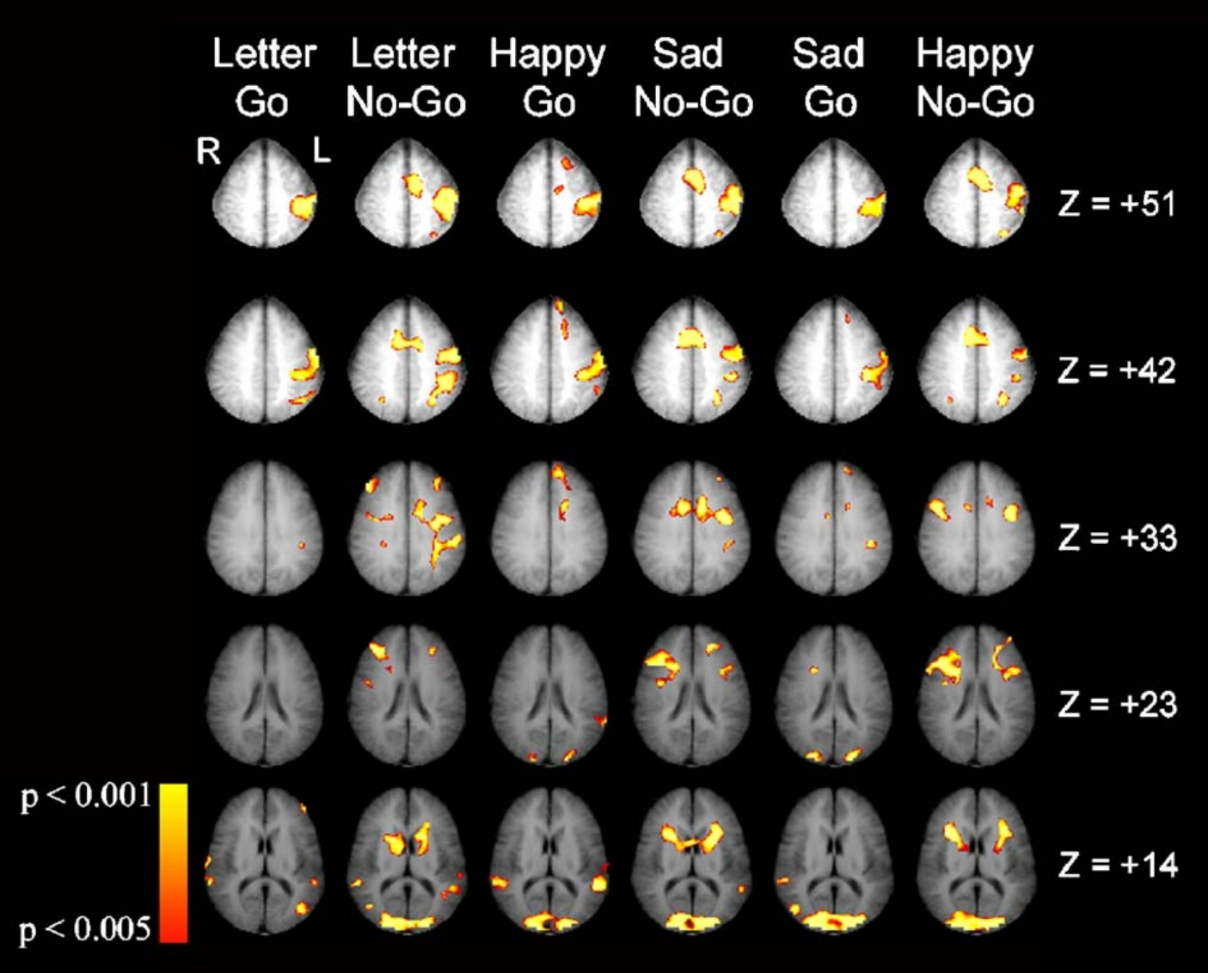
Background
The emotional Go/No-Go task involves activation in several brain regions.
Brain activations are primarily in frontal, temporal, and occipital brain regions, in addition to limbic and motor areas(Brown et al.,2016).
The amygdala and cingulate cortex, motor cortex, cerebellum, inferior frontal gyrus, right caudate nucleus and ventral striatum are detected to be activated in emotional recognition Go/NoGo tasks(Hare et al.,2005).
Notes:
The emotional Go/No-Go task involves activation in several brain regions. Also for each condition of the emotional recognition Go/NoGo task, their activities will be different.
According to fMRI observation results,
Brain activations are primarily in frontal, temporal, and occipital brain regions, in addition to limbic and motor areas.
The amygdala and cingulate cortex, motor cortex, cerebellum, inferior frontal gyrus, right caudate nucleus and ventral striatum.
This gives us regions of interest to choose from for further .

Slide 6
Background
Internet addiction has been found to be related to deficits in emotional recognition, as indicated by many studies:
Individuals with problematic internet use (PIU) and excessive smartphone use (ESU) show impairments in recognizing emotional face expressions (EFE)(Arato et al.,2023).
Specific internet addiction, such as addiction to games and social networks, has been found to be associated with impaired inhibitory control and social anxiety, which may affect emotion recognition(Dieter et al.,2017).
Internet-addicted urban left-behind children have been found to have differences in facial expression recognition, with a processing mode characterized by earlier gaze acceleration and uniform extraction of information in pictures (Ge et al.,2017). Also, they showed a preference for negative emotions in facial expression recognition (Ge et al.,2014).
Though several research have been done on Internet addiction, there haven’t been any research on the influence of short-form videos on emotion recognition with the popularity of short-form videos these years.
Notes:
Internet addiction has been found to be related to deficits in emotional recognition, as indicated by many studies. Individuals with problematic internet use (PIU) and excessive smartphone use (ESU) show impairments in recognizing emotional face expressions (EFE). Specific internet addiction, such as addiction to games and social networks, has been found to be associated with impaired inhibitory control and social anxiety, which may affect emotion recognition. Additionally, internet-addicted urban left-behind children have been found to have differences in facial expression recognition, with a processing mode characterized by earlier gaze acceleration and uniform extraction of information in pictures. Also, they showed a preference for negative emotions in facial expression recognition.Though several research have been done on Internet addiction, there haven’t been researches on the influence of short-form videos on emotion recognition with the popularity of short-form videos these years.

Slide 7
Idea
Aim 1
Whether people with short-form video addiction differ from non-addicted individuals in terms of emotion recognition
Aim 2
How people with short-form video addiction differ from non-addicted individuals in terms of emotion recognition.

Slide 8
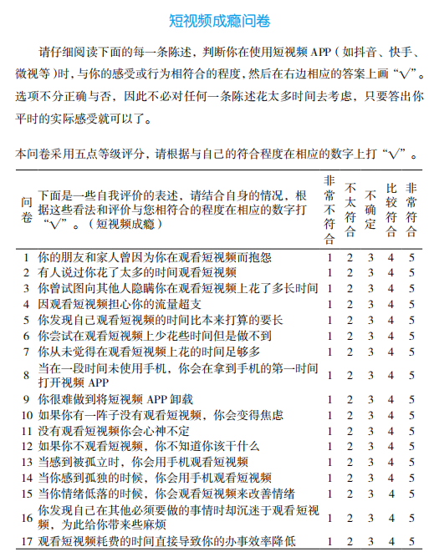
Experimental design
Participant:
10 subjects will be recruited from the University of Macau, 5 of whom were addicted to short videos and 5 of whom were normal people.
QUEATIONAIRE
The Mobile Phone Addiction Index (MPAI) (Huang et al., 2014)

Slide 9
Experimental design
Project Emotional_Recognition_go_nogo_Task
Reaction times (RT) were calculated for all “hit” responses in the six conditions. Emotional bias scores were calculated by subtracting the sad target/happy distractor condition RT from the happy target/sad distractor condition RT.
The plus sign is displayed for 1s
Show faces
Subject presses the button
Records the data stored each time
Use the PROCEDURE in git-hub

Slide 10
Experimental design
fNIRS
Happy goal (happy face button)/Sad distraction (sad face button cannot be pressed)
Happy goal/Neutral distraction
Neutral goal/Happy distraction
Neutral goal/Sad distraction
Sad goal/Happy distraction
Sad goal/Neutral distraction
For each condition above, the functional connectivity will be calculated from the raw fNIRS data.
And the difference of emotional bias scores and functional connectivity in each condition between short-form-video-addicted subjects and non-addicted subjects will be calculated to show the influence of short-form videos on emotion recognition.
While conducting the Emotional Recognition Go/NoGo task, cerebral hemodynamic changes in the subjects will be measured using an fNIRS device.

Slide 11
Potential implications
Provide insights into the underlying mechanisms of emotional processing.
Explore how emotions are regulated and processed in individuals with short-form video addiction.
Develop targeted preventions and interventions of short-form video addiction.
Decode nonverbal cues, such as facial expressions, leading to better communication and empathetic understanding between individuals.

Slide 12
THANK YOU

